Slide 1


Delta Airlines Financial Analysis
Tam Nguyen - Uyen Tran

Slide 2

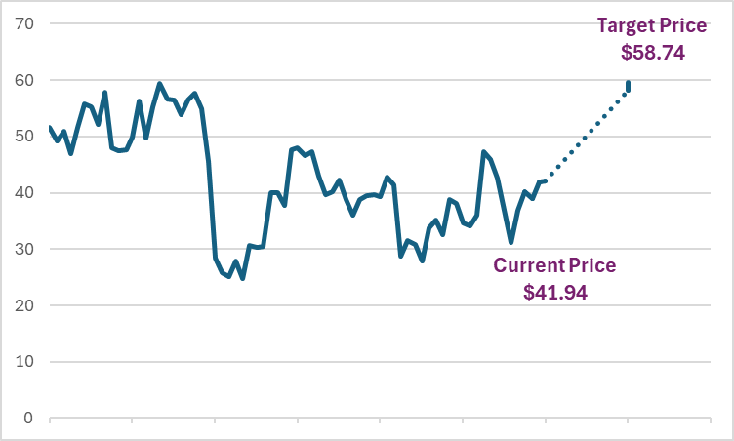


Executive Summary
Target Price: $58.74 Current Price: $41.94
(price of Feb 28, 2024)
Recommendation:
HOLD
28.6% upside
Comparables

Slide 3

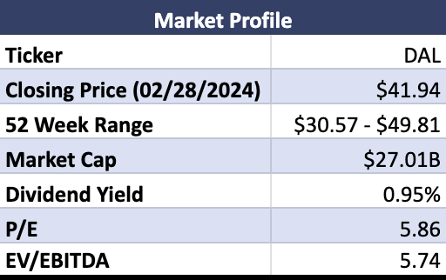
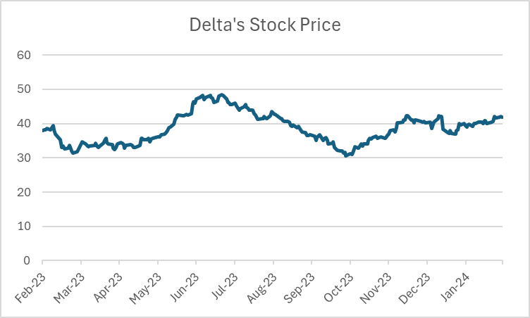
Business Overview
Delta Air Lines is one of the major airlines of the US
Delta provides products and services for passenger transport, cargo transport, air services and a customer loyalty program
Overview
Industry & Competitive Positioning
Financial Analysis
Valuation
Conclusion

Slide 4
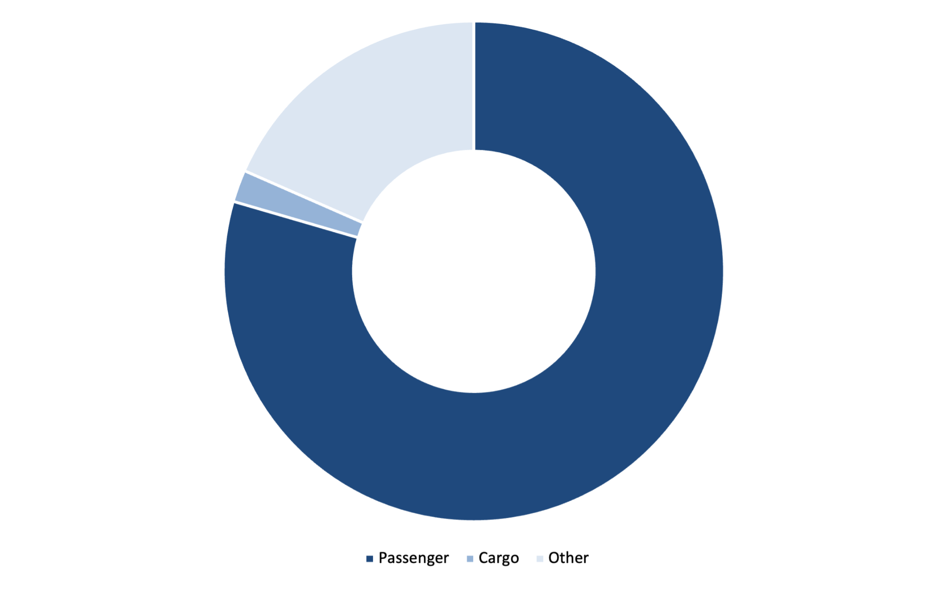
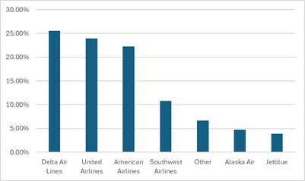
Business Overview
A major part of Total Revenue is from Passenger (81%)
Accounted for 25.57% total market share and acquired the highest revenue among its competitors
17%
2%
81%
Overview
Industry & Competitive Positioning
Financial Analysis
Valuation
Conclusion

Slide 5
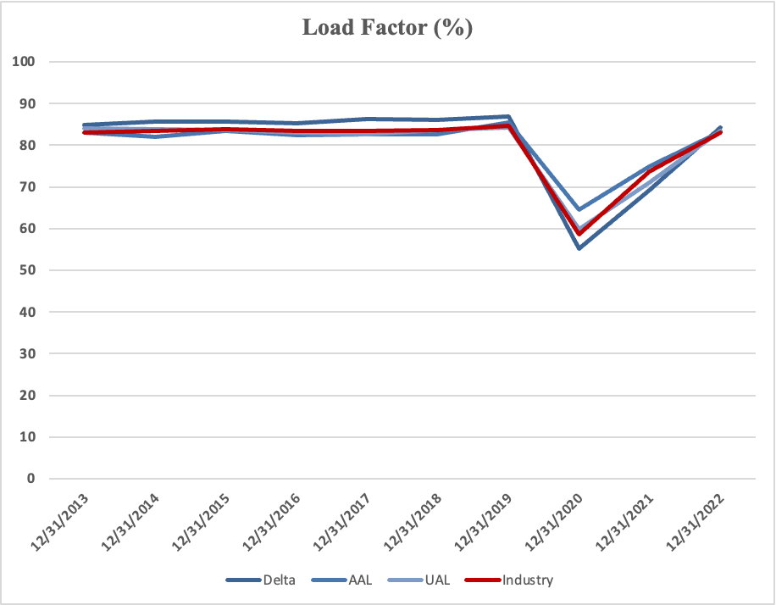
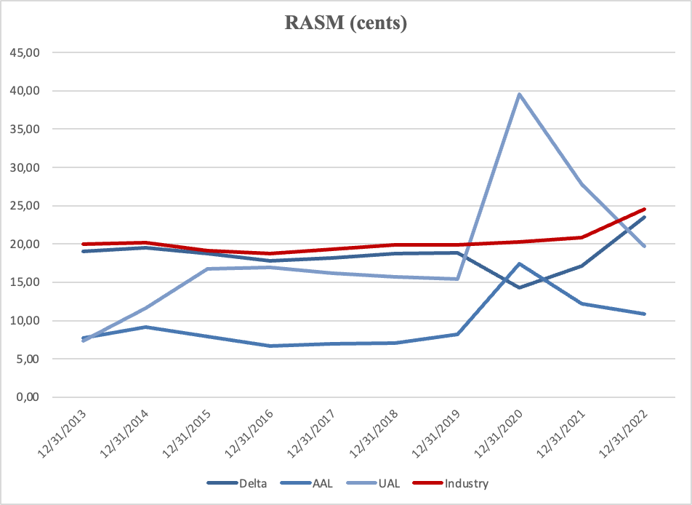
Industry Overview
KPIs
Load Factor: A consistent performance is shown for
overall industry players from 2013 to 2019.
However, the enforcement of middle seat
policy has led DAL’s load factor to decline
well below among all competitors in 2020.
RASM: DAL shows a stable trend, with a noticeable
increase at the end 2022.
➜ less volatile and effective pricing management.
Overview
Industry & Competitive Positioning
Financial Analysis
Valuation
Conclusion

Slide 6
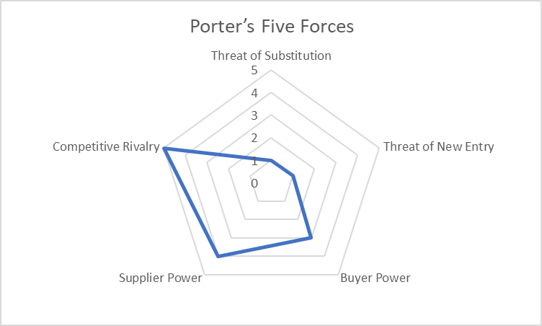
Competitive Positioning
Porter’s Five Forces
Bargaining Power of Suppliers - HIGH
Bargaining Power of Buyers - MODERATE
Competitive Rivalry - HIGH
Threat of New Entry - LOW
Threat of Substitution - LOW
Legend
0 - No threat to the business
5 - High threat to the business
Overview
Industry & Competitive Positioning
Financial Analysis
Valuation
Conclusion

Slide 7
SWOT Analysis
Strengths
Opportunities
Strong Brand Value
Enormous Fleet Size
Alliances and Acquisitions
Operational Efficiency
Strong Financial Position
Leverage Social Media
Maintenance Service
Millennial Market
Technology harnessment
S
O
SWOT
W
T
Weaknesses
Threats
Dependence on Local Market
Aircraft Concerns
High Attrition Rate
Competitive Market
Increase in Cost
Geopolitical Risk
Overview
Industry & Competitive Positioning
Financial Analysis
Valuation
Conclusion

Slide 8
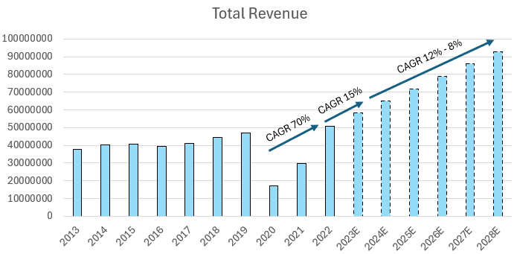
Revenue Analysis
Strong Revenue Projected
Growth Drivers
Increased in international ticket sales
Rose in the number of premium seating
A robust demand for air travel
Overview
Industry & Competitive Positioning
Financial Analysis
Valuation
Conclusion

Slide 9
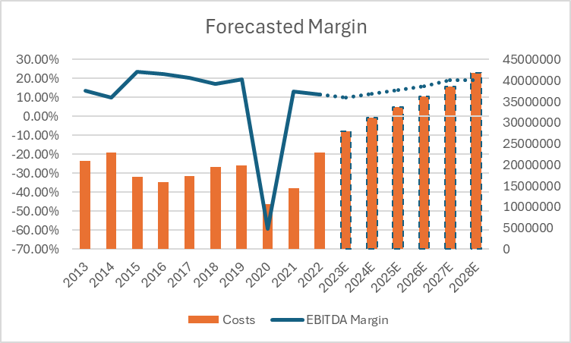
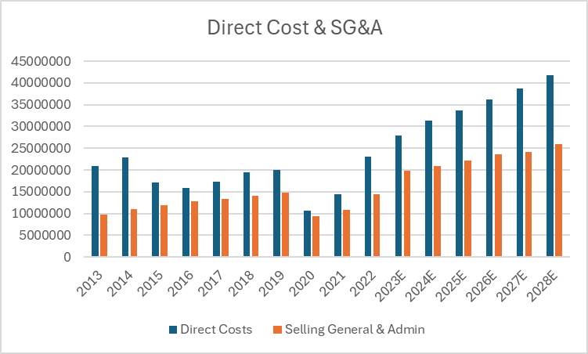
Margin
Margin Drivers
Fuel prices remain an unpredictable factor within the aviation sector
Surged labor cost
Overview
Industry & Competitive Positioning
Financial Analysis
Valuation
Conclusion

Slide 10
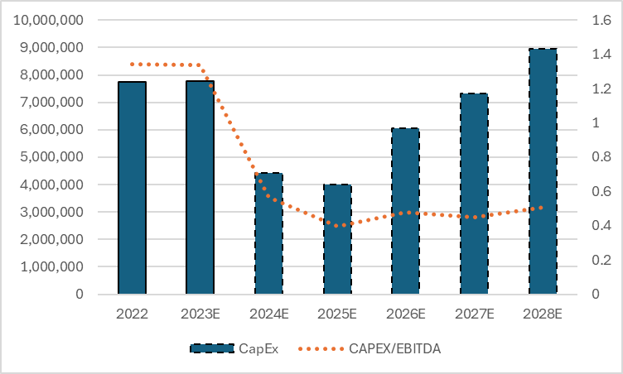
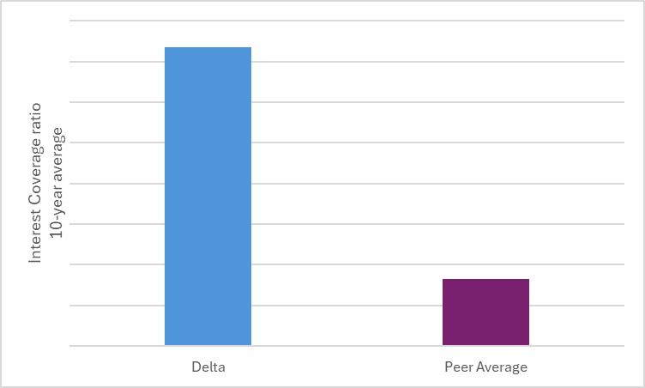
CapEx program and solid debt capacity
CapEx Projection
Superior debt capacity to peers
4.5x peers
Overview
Industry & Competitive Positioning
Financial Analysis
Valuation
Conclusion

Slide 11
Valuation Methods
50%
DCF Analysis
50%
Valuation Multiples
Overview
Industry & Competitive Positioning
Financial Analysis
Valuation
Conclusion

Slide 12
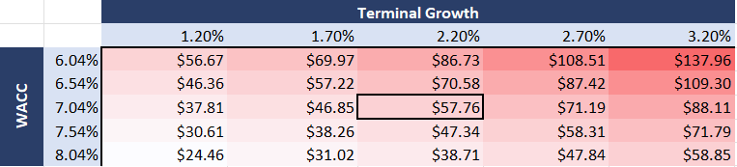
DCF
DCF TARGET: $57.84
Our DCF suggests a positive side
Cost of Debt
6%
Cost of Equity
11.7%
WACC
7.04%
Terminal Growth
2.2%
Overview
Industry & Competitive Positioning
Financial Analysis
Valuation
Conclusion

Slide 13





Relative Valuation
Peer Group
RV TARGET: $59.63
DCF
DAL
57.84
Peer Average
P/E
25.67
P/E
DAL
114.7
EBITDA Multiplier
9.81
EBITDA Multiplier
DAL
70.21
Sales Multiplier
0.38
Sales Multiplier
DAL
34.18
Book Value Multiplier
1.41
Book Value Multiplier
DAL
19.42
Overview
Industry & Competitive Positioning
Financial Analysis
Valuation
Conclusion

Slide 14
Target Price
50%
DCF Analysis
$57.84
50%
Valuation Multiples
$59.63
$58.74
Overview
Industry & Competitive Positioning
Financial Analysis
Valuation
Conclusion

Slide 15
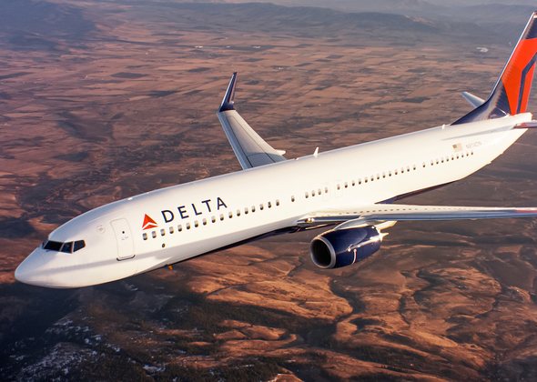
Conclusion
Target Price: $58.74 Current Price: $41.94
(price of Feb 28, 2024)
Recommendation:
HOLD
28.6% upside
Overview
Industry & Competitive Positioning
Financial Analysis
Valuation
Conclusion

Slide 16
Thank You!

